Slide 1
Introduction to REST API
28-Jan-2020

Slide 2
Problem statement
Create a REST API server with the following functionality:
Create a country object with capital and currency as fields
List all the countries available
Get data for a given country
Change a given field for a country
Collection can be imported to postman from : https://www.getpostman.com/collections/d43b6ebe305d0aec317e

Slide 3
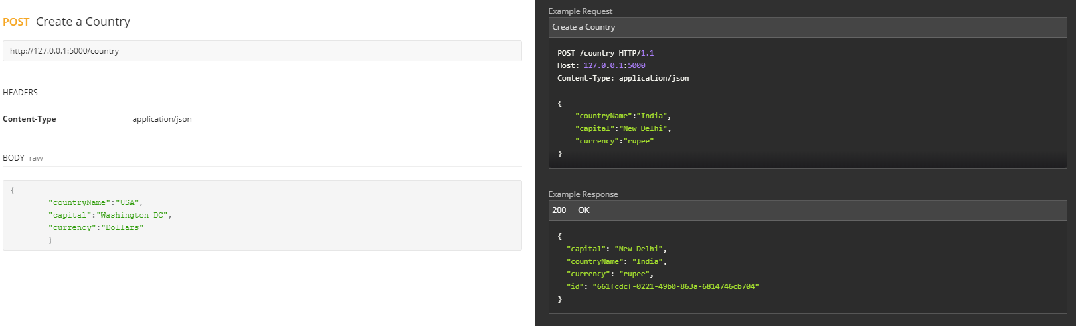
API Documentation https://documenter.getpostman.com/view/1523598/SWTABJpD
Create a country:

Slide 4
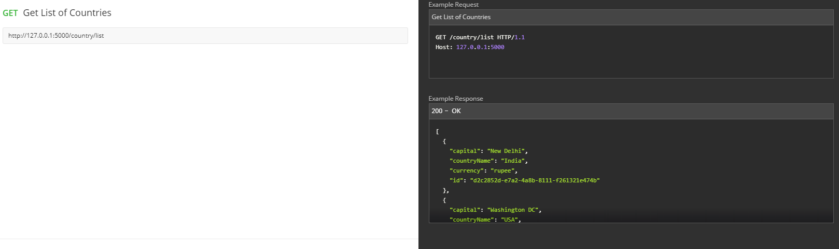
API Documentation https://documenter.getpostman.com/view/1523598/SWTABJpD
Get List of Countries

Slide 5
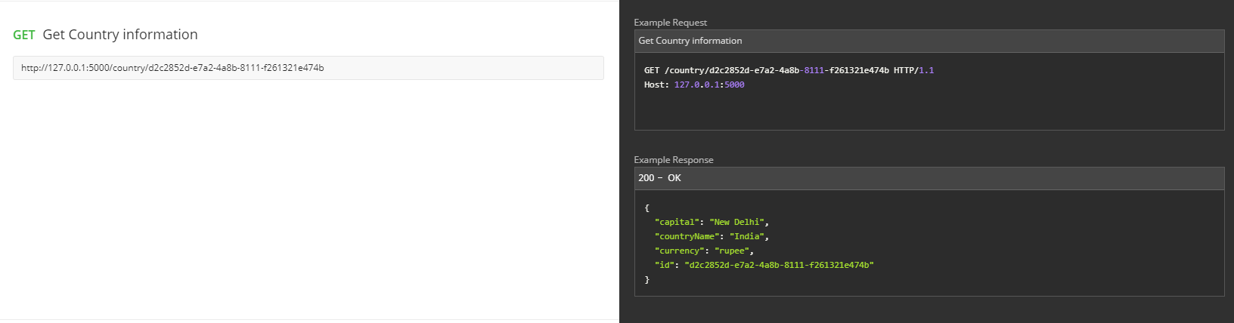
API Documentation https://documenter.getpostman.com/view/1523598/SWTABJpD
Get Details of a given country

Slide 6
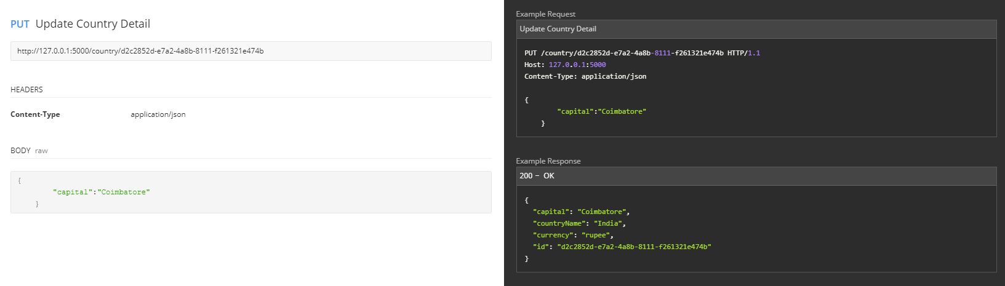
API Documentation https://documenter.getpostman.com/view/1523598/SWTABJpD
Update a country

